Slide 1
BIFX 503: Statistics for Bioinformatics
Instructor: Jennifer Schroeder, Ph.D.
Wednesdays, 5:30-8:00pm
Hodson Technology Center, Room 237
Fall 2021

Slide 2
Recursive Partitioning & Predictive Models

Slide 3
Content
Recursive Partitioning
Continuous outcome
Dichotomous outcome
Evaluating models using Predicted vs Observed

Slide 4
Multiple Linear Regression
More than one IV predict the DV:
Y is the DV
X₁, X₂, …, X_{k} are the IVs
β₀ is the intercept
β₁ , β₂, …, β_{k} are the slopes
e is error

Slide 5
Multiple Linear Regression Assumptions
Subjects are independently observed, and representative of one population
Each subject has Y and X’s
X’s and Y measured independently
Y has a Normal distribution
X’s may be continuous or categorical
The relationship between Y and each X is linear

Slide 6
Recursive Partitioning
Unlike linear regression, recursive partitioning models do not assume linear relationships between the dependent variable and each independent variable
The end goal is similar:
Predict Y, given X’s

Slide 7
Divide and Conquer
Recursive partitioning models divide the data into homogeneous subsets, based on the values of the independent variables
Subset membership correlates with the dependent variable
Partitioning based on univariate splits
Above/below a cut point selected for each variable
The dividing continues until some stopping criterion is fulfilled
When to stop is not a trivial question!

Slide 8
Partitioning Algorithms
Differ with respect to:
How the variable on which to base the split is selected at each step
How the value of the variable that defines the groups is estimated
Which stopping criterion is applied

Slide 9
Partitioning Steps
Root node is the entire dataset
Choose a variable and a split that best predicts the dependent variable
Examine all possible splits of all variables
Choose the split that results in two groups that are “purer” with respect to the values of the dependent variable
Split the data into two subsets based on the value of this variable
Subset membership is related to the dependent variable
Split each of these subsets into two more subsets based on the value of another variable
And so on, until stopping criterion is reached

Slide 10
Tree Size
When does the recursion need to stop?
Too few splits
Overly simplistic, doesn’t fit data well
Too many splits
Overfitting, won’t generalize to other datasets
Goal is often to make predictions on data different from the data that was used to derive the model
“Training” vs. “Test”

Slide 11
Pruning the Tree
Begin with a big tree and cut it back
Use model characteristics to find the optimal number of splits
Minimize cross validated prediction error
A good solution is stable
Many runs produce similar results

Slide 12
Ensemble Methods
One way around an unstable solution is to aggregate the results over many runs (ensemble method)
“bagging” (bootstrap* aggregating) to reduce variance and minimize overfitting
How it works:
Draw B bootstrap samples from original data set
Grow a large tree from each sample
Average the estimates from B trees
Why it works: “wisdom from the crowd” effect
Aggregation of information in large diverse groups results in decisions better than could have been made by any individual group member
*A bootstrap sample is a random sample drawn with replacement from the original sample.

Slide 13
Prediction
Recursive partitioning models are evaluated by their ability to predict the dependent variable
Each record in the database has a value of the dependent variable that is “predicted” by the model, based on the values of the independent variables
A good model will have a high correlation between the observed and predicted values

Slide 14
Recursive Partitioning in R
Package rpart
rpart(y ~ x1 + x2 + …, data, control)
Control refers to a list of options that control different aspects of the algorithm

Slide 15
Control for rpart
Parameters:
minsplit: minimum number of observations that must exist in a node for a split to be attempted
minbucket: minimum number of observations in any terminal node
cp: complexity parameter
xval: number of cross-validations

Slide 16
Pruning
prune(mod1, cp = cpval)
Prunes an existing RP model, stored as the variable mod1, based on complexity criteria value cp equal to cpval

Slide 17
Plotting the Results
Package partykit
plot(as.party(mod1), tp_args=list(id=FALSE))
Plots the RP model mod1

Slide 18
Predicted Values
predict(mod1, newdata = data)
Generates predicted value for new observations in the dataset data based on the RP model mod1
Note we are predicting values of the dependent variable in a sample different from the one the model is based on

Slide 19
Evaluating the Model
The model is evaluated by comparing the predicted values with the observed values
When the dependent variable is continuous, this can be done with a scatter plot
When the dependent variable is categorical, predicted vs. observed are shown in a contingency table
”confusion matrix”, shown in logistic regression lecture

Slide 20
Example: Continuous Outcome
Data bodyfat from package TH.data
Dependent variable DEXfat
Body fat measured by DXA
Independent variables
Age
Waist circumference
Hip circumference
Elbow breadth
Knee breadth

Slide 21
Example: Continuous Outcome
bodyfat_rpart <- rpart(DEXfat ~ age + waistcirc + hipcirc + elbowbreadth + kneebreadth, data = bodyfat,
control = rpart.control(minsplit=10))
Note use of control based on minsplit=10
Must have 10 observations in a node for a split to be attempted

Slide 22
Initial Tree Before Pruning

Slide 23
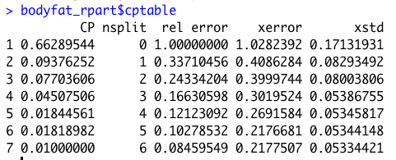
How many splits?
Want to minimize prediction error (xerror, from cptable, below)

Slide 24
Pruned Tree

Slide 25
Predicted Values

Slide 26
Conditional Inference Tree
Alternative to pruning
Stopping criterion is based on statistical significance testing
Test of independence between variable and DV
Split is established when p value less than specified value (reject hypothesis of independence)

Slide 27
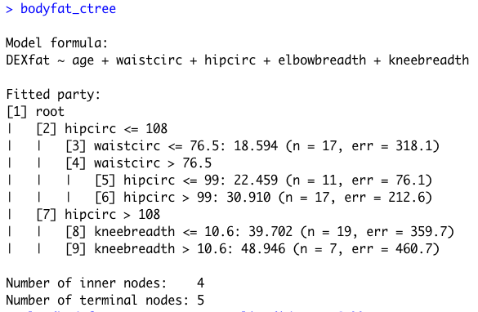
Conditional Inference Tree

Slide 28
Conditional Inference Tree

Slide 29
Example: Dichotomous Outcome
Data glaucoma from package TH.data
Dependent variable Class
“glaucoma” or “normal”
Many independent variables
Morphology of the optic nerve head
Goal is to predict class membership (glaucoma diagnosis)

Slide 30
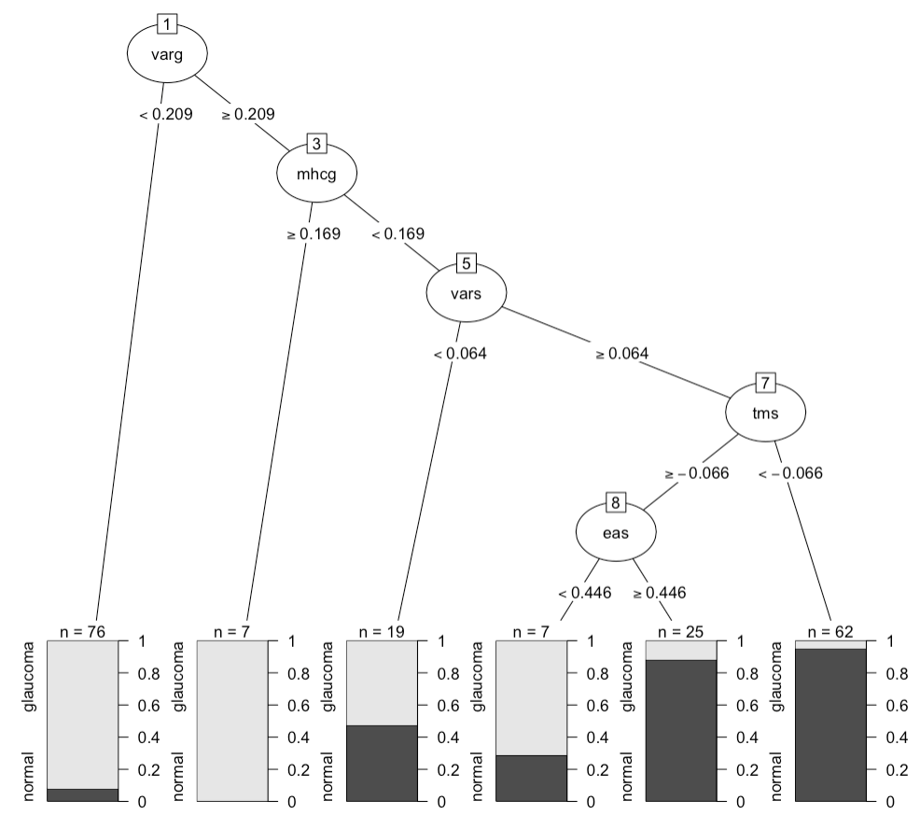
Initial Tree

Slide 31
Pruned Tree
Overly simplistic, given the number of independent variables?

Slide 32
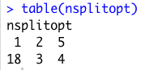
Solution is Not Stable
We are looking for consistent results over a large number of cross-validation runs
Most often, one split is optimal
As many as five splits can be considered optimal

Slide 33
Bagging
One way to deal with an unstable solution is to run many models and aggregate the results
“Ensemble” method
Each model is a large tree without pruning
Results from each model stored in a vector

Slide 34
Estimate Conditional Probability
Average the estimates over all the models
If the average conditional probability exceeds 0.5, we assign class “glaucoma”
Otherwise we assign class “normal”

Slide 35
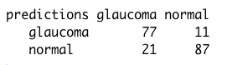
Compare Predicted with Observed
Evaluate the model by comparing the predicted class membership with the actual class membership
Dataset consists of 98 glaucoma, 98 normal
77 out of 98 glaucoma cases predicted by the model
87 out of 98 normal cases predicted by the model
Overall % Agreement = (77+87)/196=83.6%

Slide 36
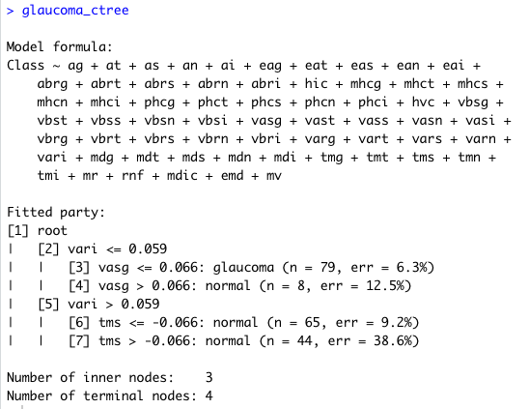
Conditional Inference Tree
glaucoma_ctree <- ctree(Class ~ ., data = GlaucomaM)

Slide 37
Conditional Inference Tree

Slide 38
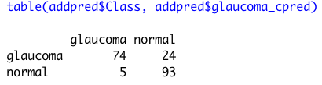
Conditional Inference Tree
Does this do any better at prediction?
74/98 glaucoma cases predicted
Does worse
93/98 normal predicted
Does better
Overall % Agreement = (74+93)/196 = 85%

